Slide 1
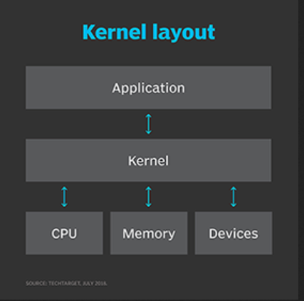

Slide 2
BIOS bootstrapping revisited
RAM
Boot Device
0x00000
Occupied
Boot block
0x00500
0x07c00
Boot block
Other data
Boot sector is copied by BIOS from boot device to memory address 0x07c00.
Kernel
0x07e00
0x9fc00
BIOS does a far jump to 0x07c0:0x0000, then it’s up to you!
This area should contain a kernel that we want to load!
Occupied
But where can we put it in RAM, and how do we do it?
0xfffff
Notes:
2

Slide 3
Memory map simplified (not to scale)
0x00000
The kernel code and data shall be copied from the boot device to memory address 0x01000!
Don’t modify!
0x00500
0x01000
Kernel
The boot sector contains the code (written by you) for copying the kernel into memory and transferring control to it!
0x07c00
Boot block
0x07e00
0x9fc00
We also need a stack, and it should be placed somewhere around here…
Don’t modify!
0xb8000
VGA Text Buffer
0xc0000
We can write to the VGA text buffer to change the characters displayed on the screen and their color attributes.
Don’t modify!
0xfffff
Notes:
3

